Slide 1
SHIFT Camera Calibration and Summary
May 5, 2022
Mauricio Hess-Flores
Mike Smyth

Slide 2
Outline
Introduction
Programs
Data
Deliverables
Camera model
Camera calibration
Camera interior orientation calibration
Camera calibration results

Slide 3
Introduction
SHIFT Campaign
Observe the same area at a high temporal frequency
First flight ~ Feburary 23; 8 weeks of flights, roughly 1 a week
AVIRIS-NG camera characteristics
Push broom camera
640 samples, with 598 included after trimming shielded pixels (?)
481 bands
365 nm – 2504 nm (?)
Line and sample pitch 27 microns
Focal length ~27 mm (?)
Time between lines – 0.0927 seconds (?)
About 5 meter resolution on the ground for expected aircraft height (?)
Goal
Adapt existing AFIDS/GeoCal/EMIT software and support geolocation processing for the SHIFT Air Campaign
Include use of ground truth to improve geolocation

Slide 4
Programs
The code essentially does this at a high level:
Loads raw data plus GPS/PPS files and computes orbit information
Creates an image-ground connection (IGC) and projects to the surface
Does tiepointing/matching over chunks of 1000 lines each and fits for exterior orientation (focal length and Euler angles)
Creates LOC/IGM/OBS output files (GLT still pending)

Slide 5
Programs
In l1b_geo directory:
aviris_ng_l1a_orbit_process
Generates the orbit and time table information from the raw input data
aviris_ng_geo_process
Performs image matching to fit the exterior orientation, generates “loc” and “obs” files
l1b_project
Produces orthorectified map projected data, both geotiff and ERDAS imagine format
These are the “real” production programs, and should be stable and reusable
Notes:
ANG radiance calibration produces rdn needed for next step
aviris_ng_l1a_orbit_pge produces the binfac?

Slide 6
Programs (cont)
In addition, have aviris_ng_support directory
This is support scripts, analysis tools, etc
run_l1a – script to submit l1a jobs to slurm
run_geo - script to submit geo jobs to slurm, and also run l1b_project
create_footprint.sh – create footprint shp files to look at where all the AVIRIS-NG data is
summarize_aviris_geo_run – summarize a single flight line of data
summarize_avirs_geo – collect all the data into a single spreadsheet

Slide 7
Programs
Assumptions:
Our automated software uses ground truth to remove slowly varying errors in ephemeris/attitude/camera exterior orientation
We can’t do much for short term jitter (e.g, line to line variation), and need to be able to match with the surface
Can’t do much with clouds or water or feature-less areas
Can interpolate/extrapolate corrections for other areas of a flight
Easiest and first implemented is static corrections
Orientation of camera to aircraft – tends to change from one flight to the next but is pretty much constant for a flight
Then correct slowly varying
Attitude errors tend to be highly correlated over short time scale (since the instrument actually measure attitude rate, and error comes from integrating the rates over time)
Do a simple model of fitting attitude correction for fixed time interval and interpolate correction for times in between

Slide 8
Data
Shift file lists here: /beegfs/scratch/brodrick/shift/line_lists/
Broken out by all lines, aquatic, tie, and ‘box’
Raw, pps, and gps files: /beegfs/store/ang/y22/raw/
.npy files:/beegfs/scratch/brodrick/shift/geotest/
Clip files: /beegfs/store/ang/y22/rdn/[FID]_rdn_v2z4_clip
The clip files are radiance products from the ANG workflow - they’re calibrated radiance outputs, where FID corresponds to the same FIDs as used for the raw, pps, and gps files
Input data set: 30m SRTM
Reference imagery
Landsat 15 m panchromatic
Sentinel data

Slide 9
Deliverables
Software to produce standard AVIRIS-NG products
GLT file (provides geo-tagging for map projected data)
LOC file (provides geo-tagging for pixel data)
OBS file (provides miscellaneous parameters – view angles, sun angles, etc)
ATT file (produces original and corrected navigation)
Updated camera model (corrected exterior orientation – not really a product, more an internal file)
Quicklook PNG and KMZ file
Evaluation of geolocation results
Validation of camera interior orientation
Estimate of geolocation accuracy relative to reference imagery

Slide 10
Camera model
The camera model is traditionally divided into two categories:
The exterior orientation
This is the orientation of the camera relative to the platform we are acquiring data for
For the camera model we are using, this is captured as 3 Euler angles giving the orientation of the camera relative to the INU unit
The interior orientation
This is the internal geometry of the AVIRIS-NG unit
There are a number of ways to capture this but we use a simple description of field alignment model. This gives the equivalent x,y location for each camera sample if we modelled this as a pinhole camera, so in the camera coordinate system a look vector for sample i is given by [x_i, y_i, focal_length].
We capture this as a GLAS/GFM camera model
This is a DOD standard used by the NITF standard file format (Appendix AH of STDI-0002-1).
We don’t actually bother saving this in the NITF format, but we use the same description of the camera because it is a convenient standard (and we already have code in AFIDS/GeoCal to support this)
Save GLAS camera model using boost serialization (https://www.boost.org/doc/libs/1_79_0/libs/serialization/doc/index.html)
XML format that allows generic objects to be written or read from disk
Very much like a python ”pickle” format, or java “serialization” but for low level C++ objects
AFIDS/GeoCal has the machinery in place for this, so in practice this is just a “read” and “write” call on the objects at the python level

Slide 11
Camera model (cont)
The interior orientation is largely static
It is a description of the actual as built camera
Should be stable over time
Worth recalibrating occasionally, but don’t expect to actually change
Focal length is an exception
Often there is a small temperature dependency on focal length (so things swell or shrink slightly as the temperature changes)
Don’t expect huge changes here, but worth updating for each flight
For the SHIFT campaign, saw ~0.09% change in focal length between flight lines – which is not atypical. This is about 1/3 a pixel correction at the edges of the camera

Slide 12
Camera model (cont)
Exterior orientation
Do expect this to change
There is often physical coupling between the instrument and the aircraft platform, and things can shift
Don’t expect huge changes – just minor tweaks
Often a bit of a pseudo term.
We can’t cleanly separate slowly varying errors in the INU units measurement of attitude from a change in exterior orientation
Can use the exterior orientation to include both terms
Essentially captures all the error sources in the attitude
For SHIFT campaign, saw ~0.15 degree changes across flight lines (about a 1 pixel correction)

Slide 13
Camera calibration
We handle exterior and interior orientation differently
AFIDS/GeoCal uses image matching with a reference image (Sentinel data) to fit the exterior orientation for each flight line
3 Euler angles
Focal length (although this is interior orientation, it often gets treated like the exterior orientation
Interior orientation is frequently calibrated in the lab
E.g., Collimator used to measure pixel field angles
EMIT/ECOSTRESS each had optical engineer supply a spreadsheet with field angles
AVIRIS-NG apparently did not have this performed
At least Phil couldn’t find lab measurements

Slide 14
Camera calibration (cont)
Previous camera calibrations appear to have been performed using ground control points
Not sure if this was automated or manual
Data for this is at aviris_ng_support/camera_model_historical
Initial used 2017 camera model, but found significant misregistration
5-8 pixel co-registration errors at the edges of the camera
Not sure if the data was just registered badly, or if something has changed.
Field alignment shown in the next few slides

Slide 15
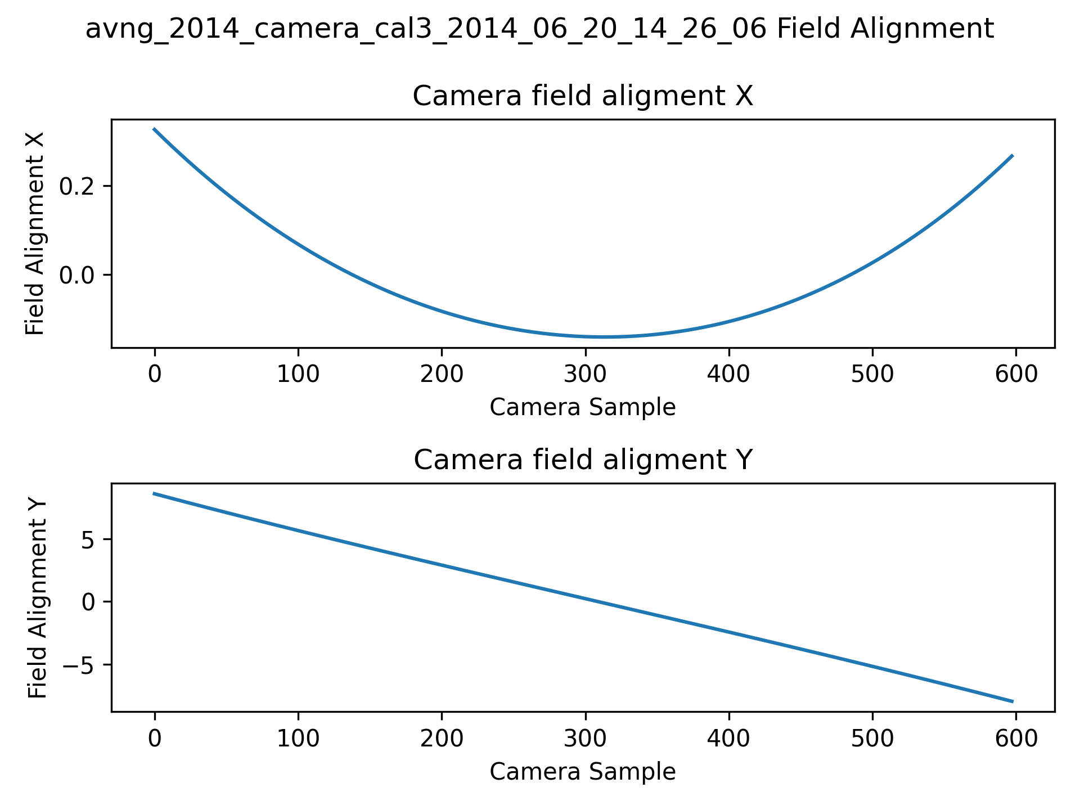
Camera calibration (cont)

Slide 16
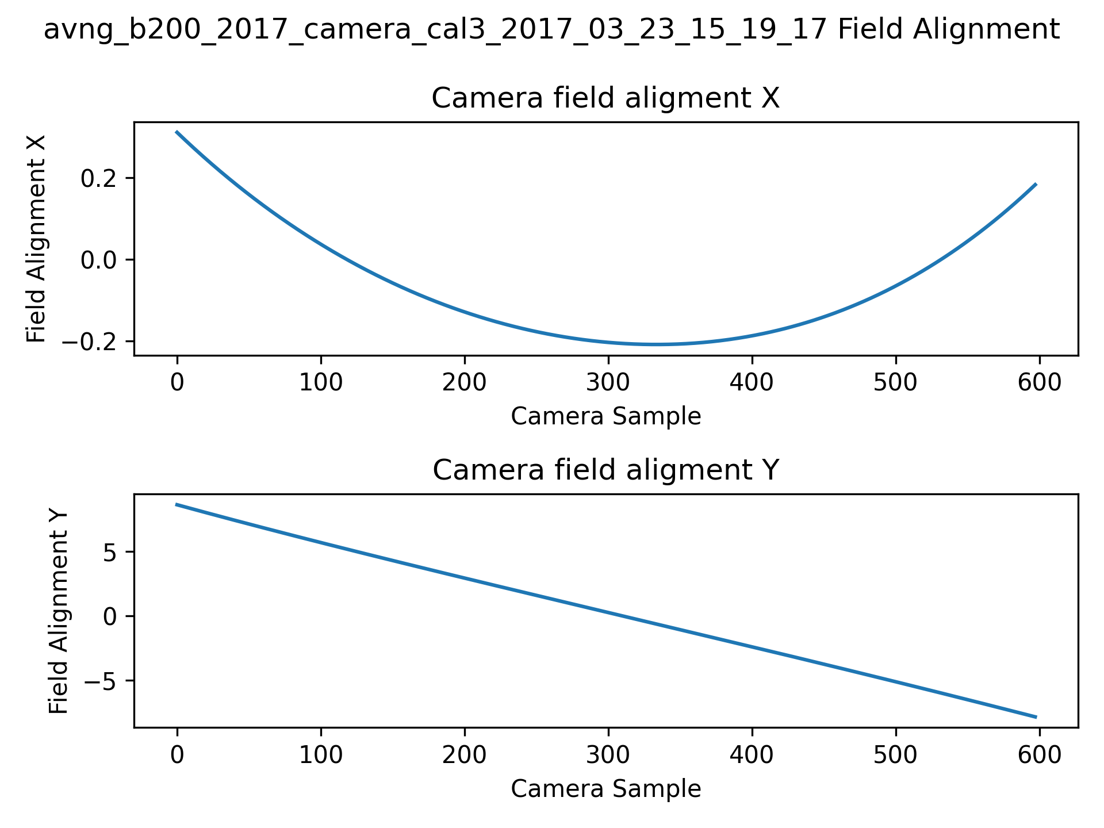
Camera calibration (cont)

Slide 17
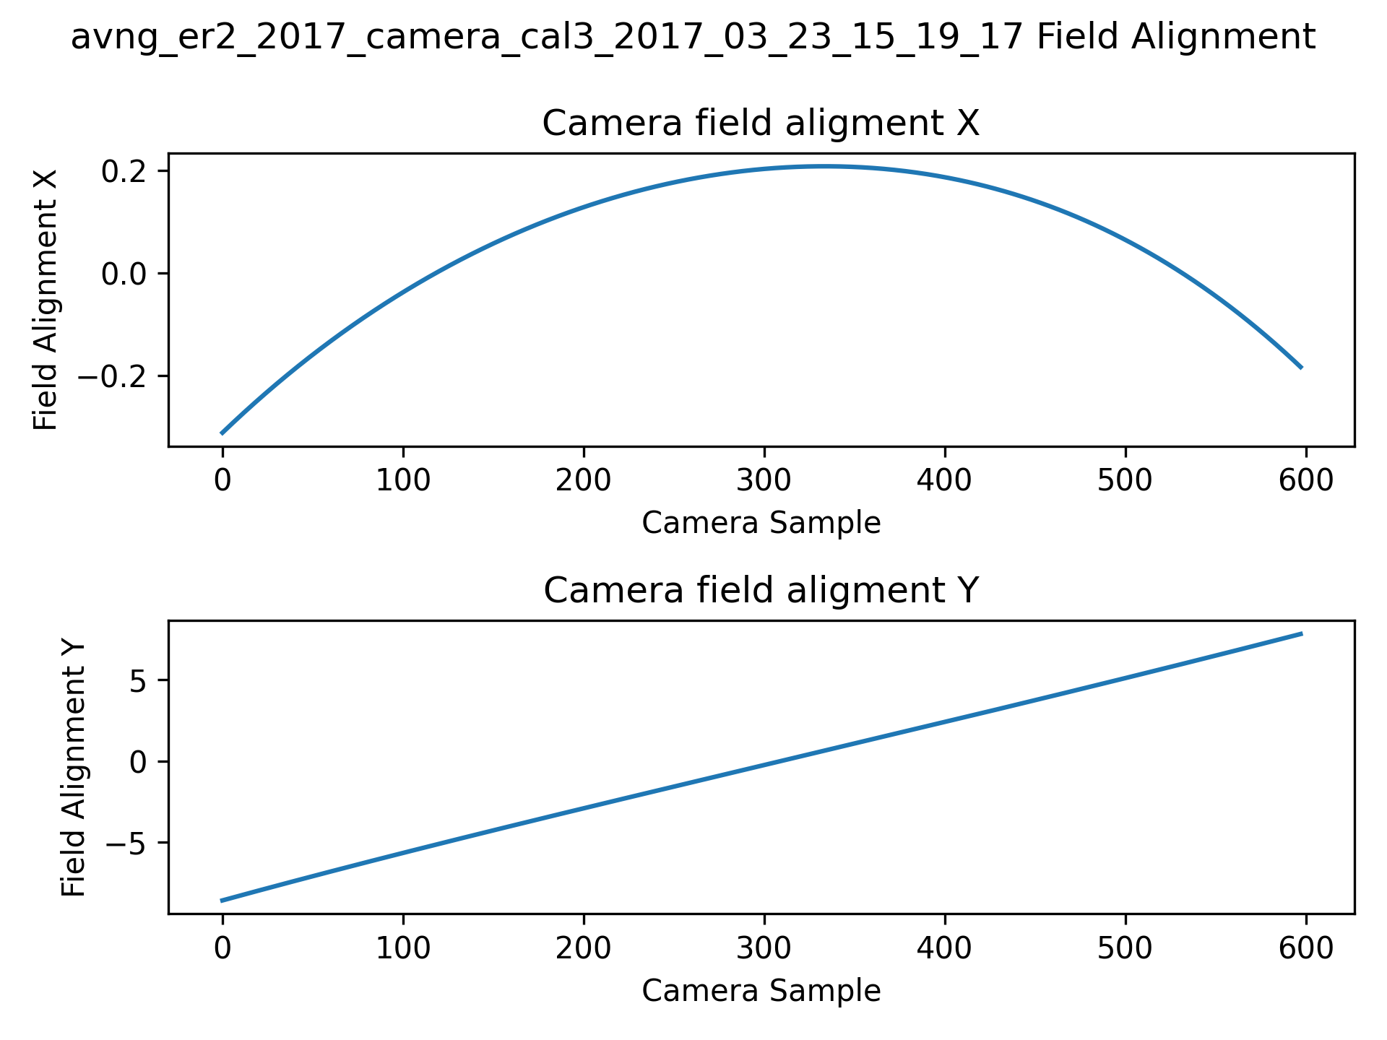
Camera calibration (cont)

Slide 18
Camera interior orientation calibration
We decided we needed to recalibrate this
Use automated tie-point collection between “tie lines”
Selected 3 lines to calibrate with:
ang20220224t204803
ang20220224t211618
ang20220224t223027
The third line is perpendicular to the other two, see the footprint in the next slide

Slide 19
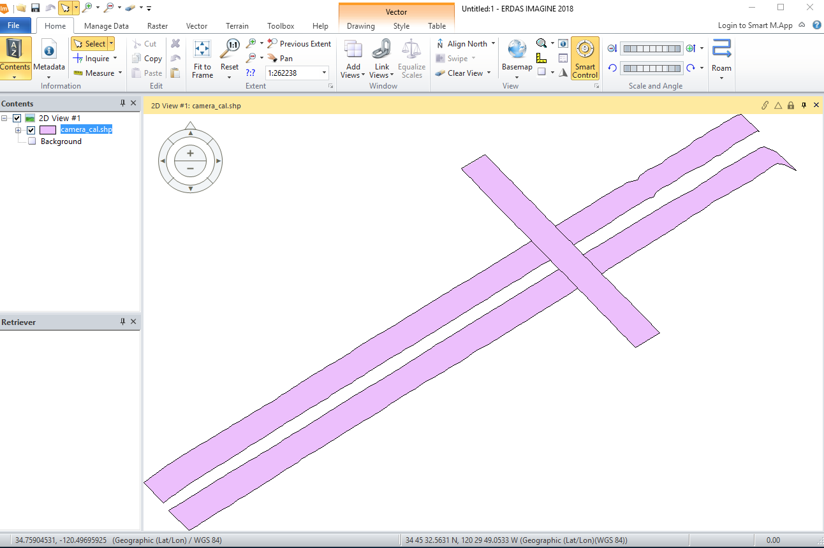
Camera interior orientation calibration (cont)

Slide 20
Camera interior orientation calibration (cont)
Calibration
Have a short program at aviris_ng_support/fit_camera.py that created a camera model fitting these tie lines
Image matching between lines to create tie-points
Fit camera model so tie-points match between the line
The data was smoothed by fitting it to a 5th order Chebyshev polynomial in the X and Y direction
Results in aviris_ng_support/camera_model_fitted

Slide 21
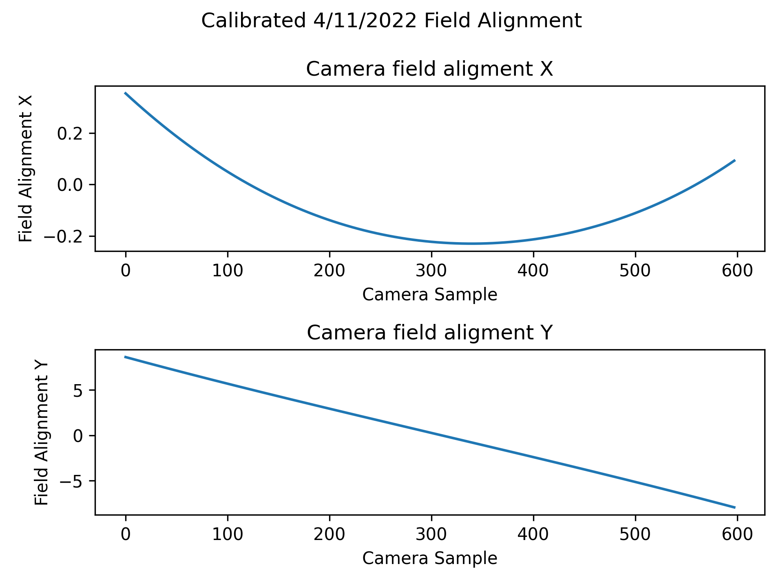
Camera interior orientation calibration (cont)

Slide 22
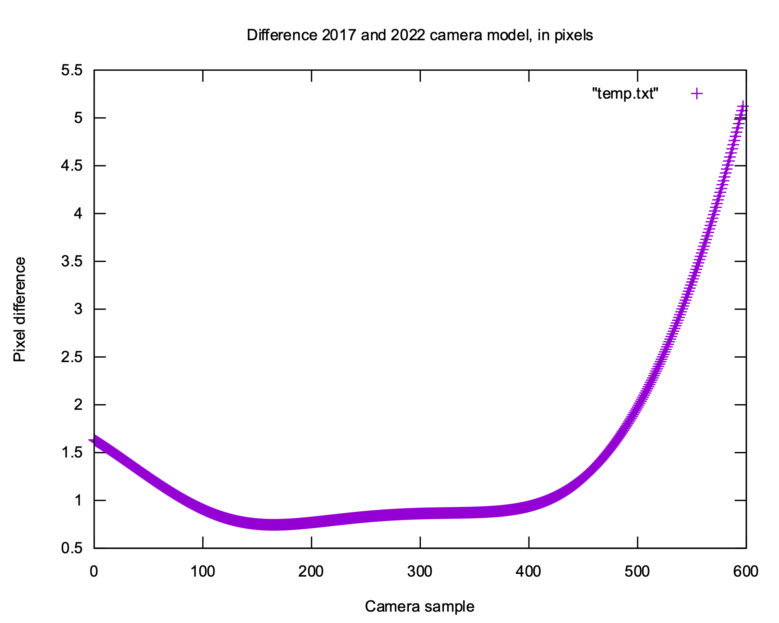
Camera calibration results
It is a bit hard to interpret the field alignment plots directly, but we can calculate the difference in pixels between the 2017 camera calibration and our 2022 calibration:

